Slide 1

Pediatric Surge Triage and Decontamination of Children During an MCI
Dr. Paula Fink Kocken, Children’s Minnesota | Ross A. Chávez, Hennepin EMS
2018

Slide 2
Objectives
After viewing this module, the participant should be able to:
Summarize the unique characteristics of pediatric triage during a mass casualty incident (MCI).
Review Jump-Start triage.
Understand unique needs of children when being decontaminated.

Slide 3

Triage

Slide 4
Won’t triage be done by EMS at the scene?
A large volume of victims are often transported by police or private car.
Mass shooting examples:
Colorado movie theater
Orlando nightclub
Las Vegas music festival
Be prepared to triage!
Secondary triage.
Notes:
We know from experience during mass casualty incidents, for example, the Aurora, Colorado movie theater shooting, the Orlando night club shooting and the recent Las Vegas shooting, that a large volume of victims will be transported by police or in a private car. They may never see a medical professional before walking into the Emergency Department.
Hospitals should be prepared to triage a surge of patients presenting directly from the incident having received minimal first aid. Additionally, even if patients are transported by EMS to the hospital, their triage status may have changed and secondary triage may be necessary.

Slide 5
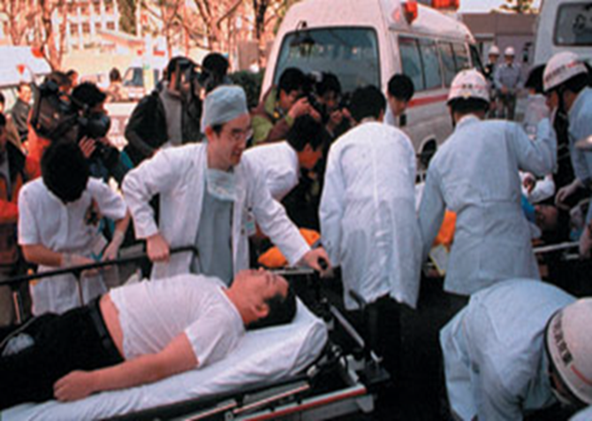
Triage: To do the most good for the most patients
Sort the Victims in to categories of treatment need according to severity of injury
Ambulatory (GREEN)
Delayed (YELLOW)
Immediate (RED)
Deceased/Expectant (BLACK)
YELLOW
Notes:
The goal of triage is to do the most good for the most patients when there is an overwhelming number of patients. You must assign a degree of urgency to wounded or ill patients. A universal color system is often utilized to sort patients.
A patient is given a green rating when they are ambulatory. These are the “walking wounded.”
Yellow patients are those you can delay in treating. They need treatment, but at the initial assessment, they are not emergent.
Patients that need to be seen immediately or else they may die are given the color red.
Patients that have already passed away are given a black tag.
Remember, triage is a dynamic situation, just because a patient is yellow when they walk through your door doesn’t mean they will stay there; a yellow patient who’s treatment is too delayed may progress to a red status or even black. This is why it is so important to always re-assess and re-evaluate your patients.

Slide 6
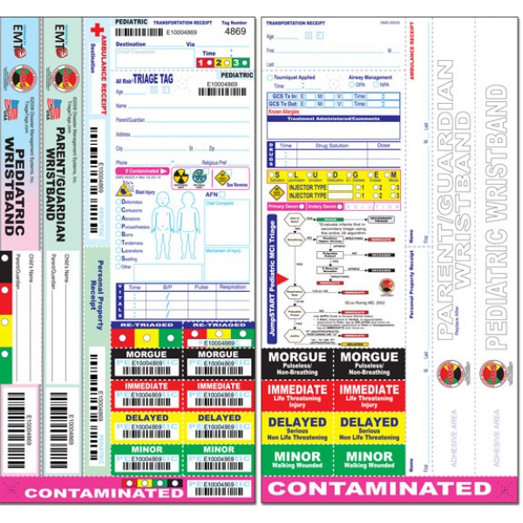
Common Triage Tag
Notes:
Here is an example of a common pediatric triage tag.

Slide 7
Triage: To do the most good for the most patients
How do children differ from adults during a MCI?
Behavior
May not follow instructions
May hide from rescuers
May wander away
Vital Signs
Airway/Breathing
If they are apneic, it is likely because of respiratory not cardiac problems
Can improve if the airway is opened and patient is given rescue breaths
Notes:
Children are not tiny adults. Their responses to a mass casualty incident can be very different than adults. Children may not follow instructions, they might hide from rescuers or wander away from the scene. Some children may even run to a disaster, thus put themselves in more danger.
Children’s vital signs vary with age and environmental conditions. They are more likely to respiratory arrest than adults. Therefore, if they are apneic it is likely due to an airway issue and not cardiac issues. As a responder you can improve a child’s chance of survival by opening their airway and giving rescue breaths when they are apneic or unresponsive.

Slide 8
START Triage
Simple Triage And Rapid Treatment
Primary triage strategy used in adult MCI’s in the US and around the world
Utilizes the standard four triage categories
Spend only 30 seconds triaging each victim
Used for primary triage
www.start-triage.com – materials available for purchase
Notes:
Simple triage and rapid treatment or START triage is a great system for pediatrics. Other triage systems like SALT (Sort-Assess-Life-Saving Treatment) has not adapted well to pediatric patients.

Slide 9
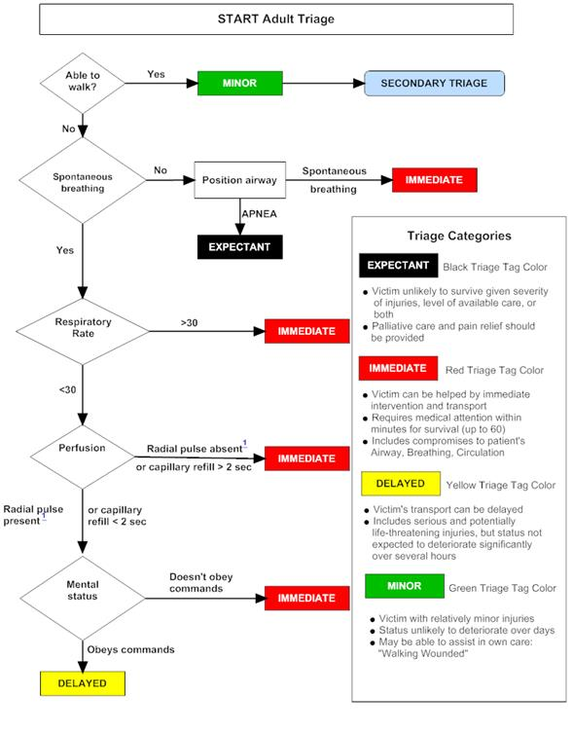
START Algorithm
Notes:
This algorithm is only for adult patients. It does not take into account the differences between pediatric and adult physiology.

Slide 10
START Triage for Kids
Alterations in START were done to adequately treat all victims not just adults or children
Dr. Lou Romig created JumpSTART which integrates START triage with a few pediatric key additions allowing for proper triage of children and adults.

Slide 11
JumpSTART
Designed for ages 1-8 years old
Can be used for infants
For the “tweens” 9-14, the caveat is “if they look like a child, use JumpSTART, if they look like an adult, use START”
www.jumpstarttriage.com
Notes:
Potential weaknesses – Little evidence base

Slide 12
JumpSTART
As with START, in JumpSTART you are to spend only 30 seconds triaging each victim
As soon as you have the victim assigned a category, you move on to the next victim
Other caregivers should be assigned to either treat or transport the victim

Slide 13
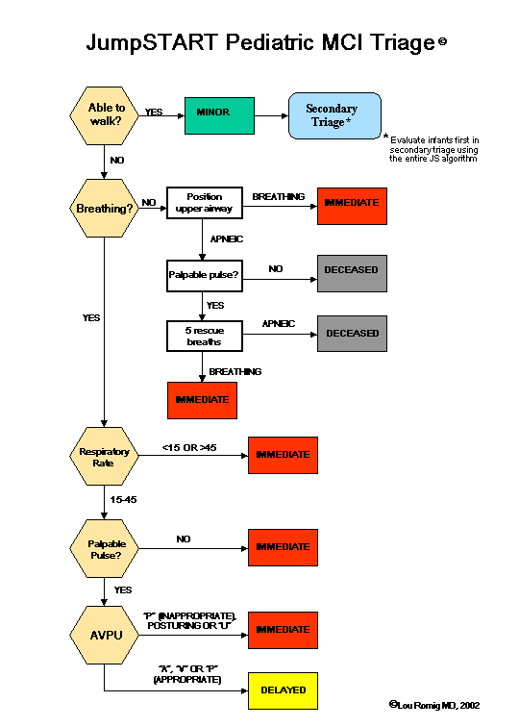
JumpSTART Algorithm
Notes:
Here is the algorithm for JumpSTART. We will break it down to the components.

Slide 14
JumpSTART: Ambulatory?
Green Patients
All ambulatory patients
Children with Special Healthcare Needs who are chronically non-ambulatory and minimally injured
Direct all Green patients to an area for secondary triage
Children Need:
Close monitoring
Diversions (toys, videos, etc.)
Notes:
Walking through the JumpSTART algorithm first identify your ambulatory patients but shouting out if anyone can walk, to move to a designated area for secondary triage.
Children with special health care needs who are chronically non-ambulatory and minimally injured can also fit into green.
Remember, if there are numerous children, you will need monitors and diversions for children who are in the green triage area. Monitors would be other providers at the scene, or adult ambulatory/green victims.

Slide 15
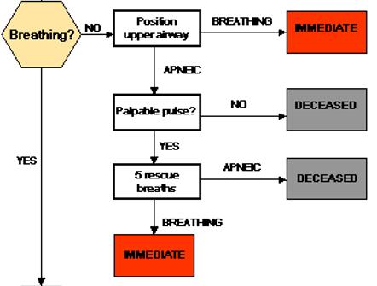
JumpSTART: Breathing?
If breathing spontaneously, go on to the next step, assessing respiratory rate.
If apneic or with very irregular breathing, open the airway using jaw thrust or chin lift.
If positioning results in resumption of spontaneous respirations, tag the patient immediate and move on to the next victim.
Notes:
If a child is not ambulatory, first step is to assess their breathing.

Slide 16
JumpSTART: Breathing?
If no breathing after airway opening, check for peripheral pulse. If no pulse, tag patient deceased and move on to next victim.
If there is a peripheral pulse, give 5 rescue breaths. If apnea persists, tag patient deceased and move on to next victim.
If breathing resumes after the 5 breaths, tag patient immediate and move on to next victim.

Slide 17
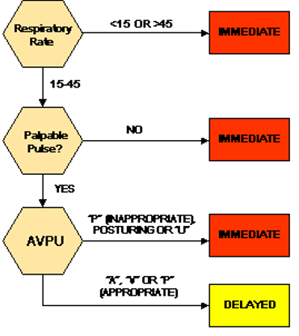
JumpSTART: Respiratory Rate
If respiratory rate is 15-45/min, proceed to assess perfusion (pulse).
If respiratory rate is <15 or >45/min or irregular, tag patient as immediate and move on to the next victim.

Slide 18
JumpSTART: Perfusion
If peripheral pulse is palpable, proceed to assess mental status.
If no peripheral pulse is present (in the least injured limb), tag patient immediate and move on to the next victim.

Slide 19
JumpSTART: Mental Status
Use AVPU scale to assess mental status.
If Alert, responsive to Verbal, or appropriately responsive to Pain, tag as delayed and move on to the next victim.
If inappropriately responsive to Pain or Unresponsive, tag as immediate and move on to the next victim.
delayed

Slide 20
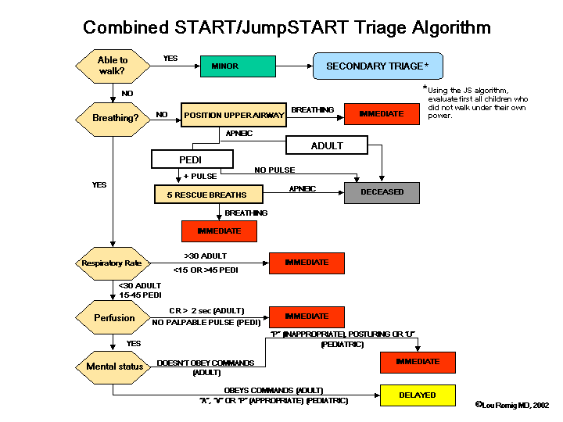
Combined START/JumpSTART Algorithm

Slide 21
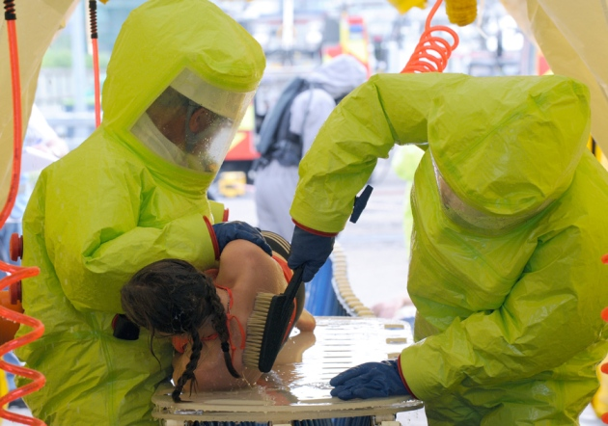
Decontamination

Slide 22
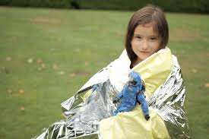
Decontamination Overview
Protect yourself first
Protect the patient while decontaminating
Notes:
Remember the purpose of decontamination; prevent the contaminate from causing poisoning, prevent contamination of providers and prevent contamination of the facility. Always protect yourself as a responder first.
You must also protect the patient while treating the exposure.

Slide 23
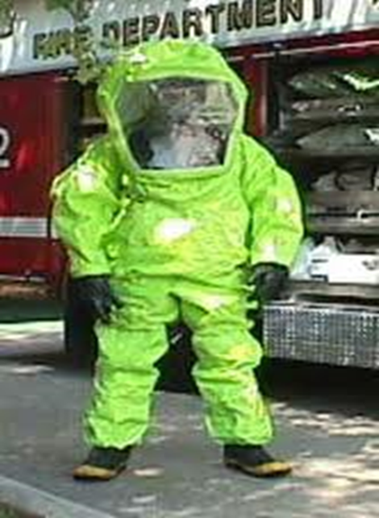
Protect Yourself
Determine the type of decontamination
Do you really need to decon?
Can you do it as dry decon?
What is the risk of the poison to the providers?
What type of PPE?
Notes:
You cannot treat a patient exposed to a poison if you are succumbing to a poison. Find out what the contaminant is, find out what type of decon to do. Over 90% of contamination can be removed with dry decon.

Slide 24
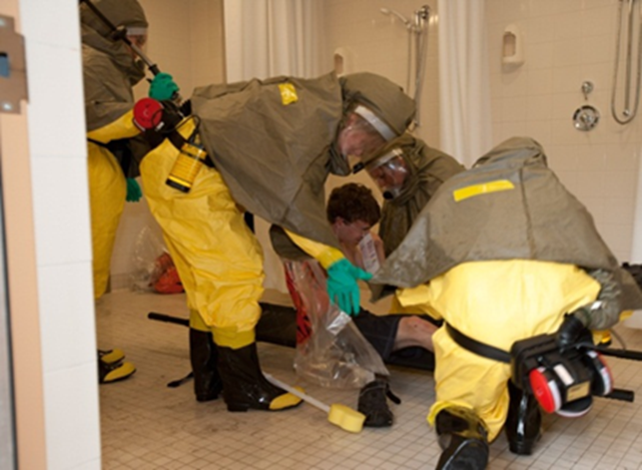
Protect the Patient
Protect the patient while treating exposure
Scary PPE
Patient identification and clothing identification
Temperature control
Keep family together
Large Volume of Patients
Same Sex
Same Age
Notes:
As a provider/responder you need PPE to protect yourself. However, to a child you may look very scary. Do you remember the scene from ET when the scientists some into the house? It was scary! Remember to smile and talk to the children as you take them through the process of decon.
Patient ID ???
Warm water, but not hot water is preferable for comfort. You must be careful to not scald infants if performing wet decontamination.
Keeping families together will help when decontaminating children.
In large volume incidents, try to group the children by sex and age.

Slide 25
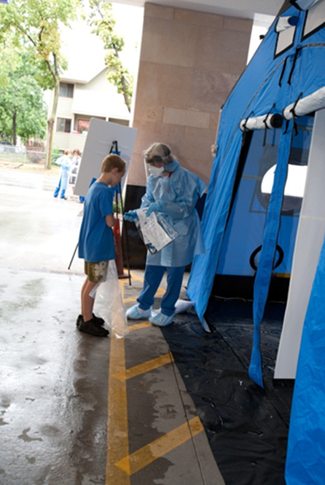
Protect the Patient
Age appropriate decontamination
Assume it will take longer
Children may not “follow” instructions
Estimate age by visual inspection
Infants and toddlers, 0-2 years
Pre-School age 2-8 years
School age 8-18 years
Non ambulatory Special Health Care Needs

Slide 26
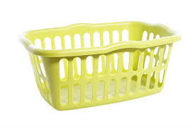
Protect the Patient
Infants and toddlers, 0-2 years
Care givers should not carry children for fear of dropping them or falling
Consider placing them in plastic clothes hampers for decontamination
Consider putting them on gurneys with one-to-one provider/caregiver

Slide 27
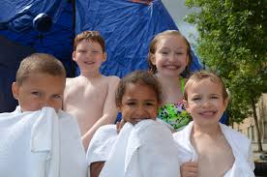
Protect the Patient
Pre-School age 2-8 years
Direct supervision and accompany through decon
School age 8-18 years may go through independently
Non-ambulatory: Special Health Care Needs
Direct supervision and may need to be placed on a gurney with restraints

Slide 28
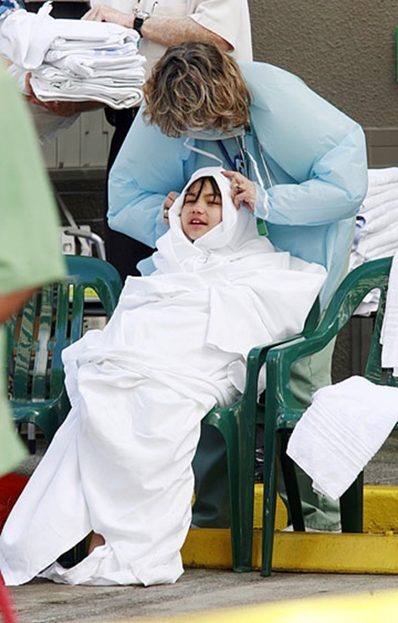
Conclusion
Pediatric Triage
JumpSTART
Pediatric Decontamination
Be prepared
Keep them Warm
Do no harm

Slide 29
Thank you!
Pediatric Surge Project
Health.HPP@state.mn.us
651-201-5700

